Slide 1
All Pairs shortest paths using Dynamic Programming

Slide 2
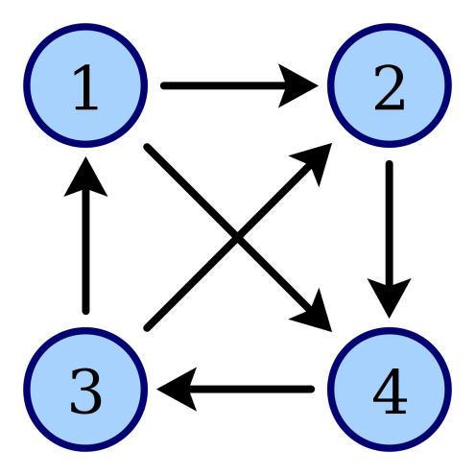
Problem:
Given a weighted digraph G=(V,E) determine the length of the shortest path (i.e., distance) between all pairs of vertices in G . Here we assume that there are no cycles with zero or negative cost.
2
1
2
1
3
2
3
3
1
4
4
4
2
4
3
1

Slide 3
Solutions
Dijkstra's algorithm
It’s a single source shortest path algorithm ie single vertex to all other vertices
Time complexity O(|E| log |V| )
If graph is dense then E= |V² | then complexity is O(|V²| log|V| )
If this algorithm runs for all vertices in the graph then complexity will become O(|V³| log|V| )
Will not work for negative edge weights

Slide 4

Solutions
Bellman – Ford algorithm
Slower than Dijkstra's algorithm but allows negative edge weights
It’s a single source shortest path algorithm ie single vertex to all other vertices
Time complexity O(|E| |V| )
If graph is dense then E= |V² | then complexity is O(|V³| )
If this algorithm runs for all vertices in the graph then complexity will become O(|V⁴| )
Will not work for negative cycles in the graph

Slide 5
Solutions
Floyd-Warshall algorithm
It helps to find the shortest path in a weighted graph with positive or negative edge weights.
A single execution of the algorithm is sufficient to find the lengths of the shortest paths between all pairs of vertices.
Time complexity O(|V³|)
Negative-weight edges may be present, but no negative-weight cycles.

Slide 6
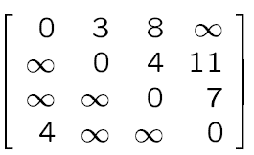
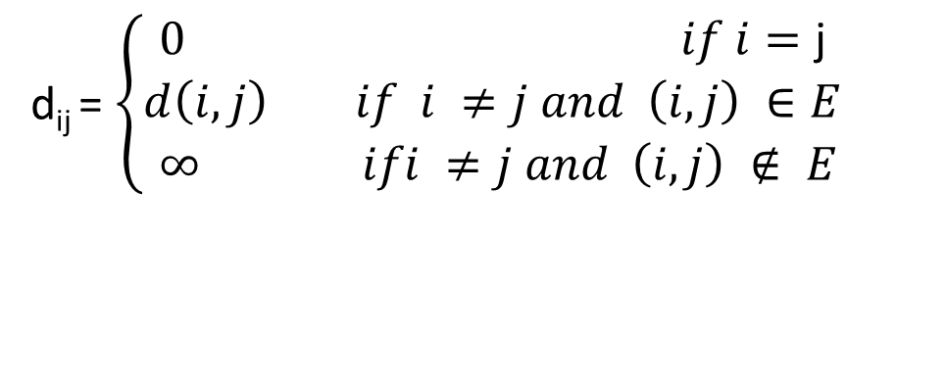
Floyd-Warshall algorithm
D
i
The all-pairs shortest-path problem is to determine a matrix D such that
d(i , j) is the length of a shortest path from i to j.
j
d_{ij} = $\left\{\begin{aligned}0 if i=\text{j} \\ d\left(i,j\right) if i ≠j and \left(i, j\right) ∈E \\ ∞ ifi ≠j and \left(i, j\right) ∉ E\end{aligned} \right.$

Slide 7
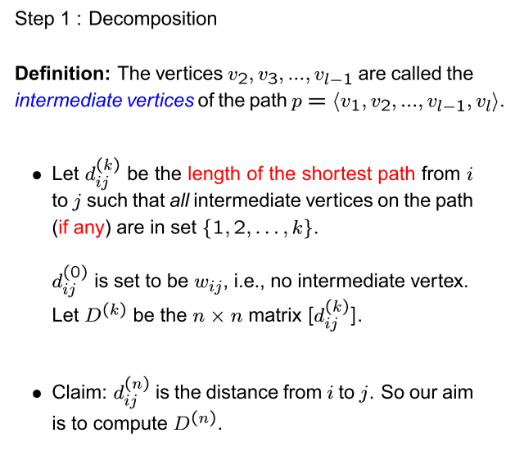

Floyd-Warshall algorithm

Slide 8
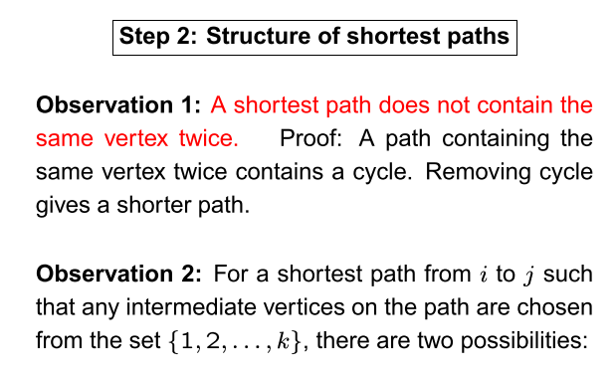
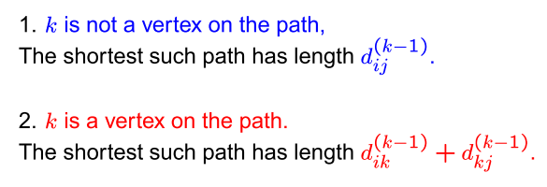
Floyd-Warshall algorithm
Shortest path from i to k
Shortest path from k to j

Slide 9
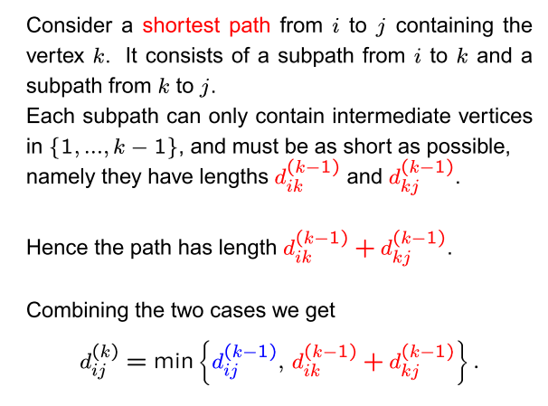
Floyd-Warshall algorithm

Slide 10
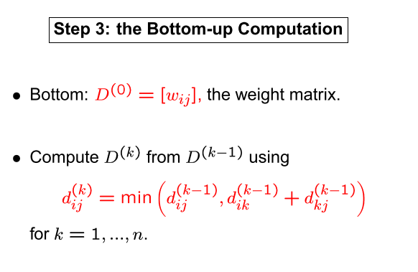
Floyd-Warshall algorithm

Slide 11
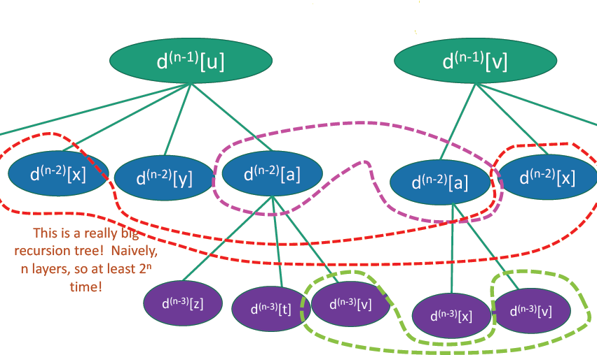
Do we have any sub optimal structure and overlapping sub problems

Slide 12
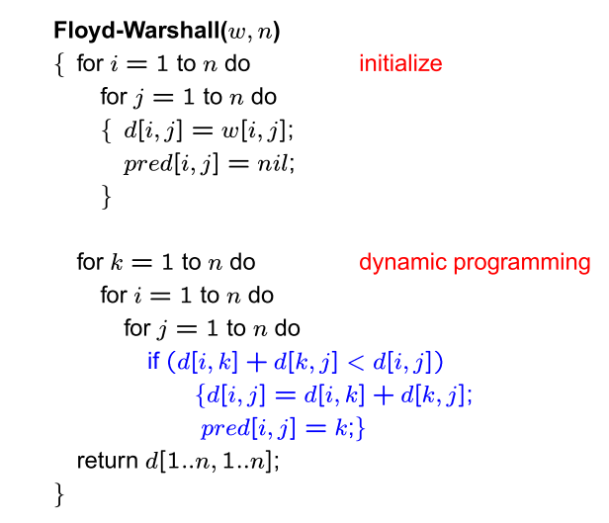
Floyd-Warshall algorithm

Slide 13
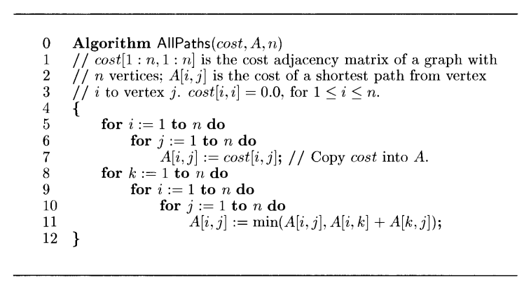
Floyd-Warshall algorithm

Slide 14
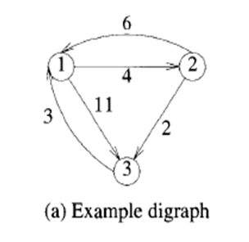

Slide 15
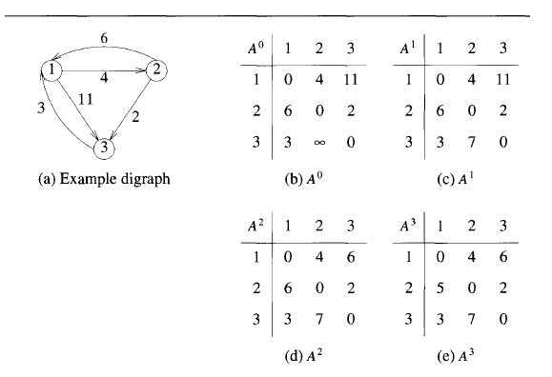

Slide 16
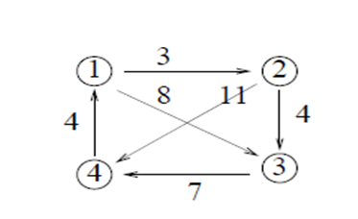
EXAMPLE

Slide 17
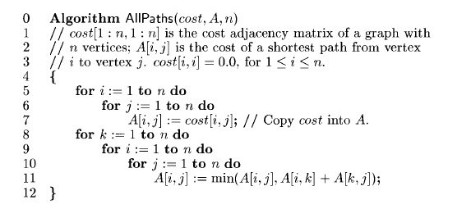
Time Complexity : O(n³)

